Slide 1
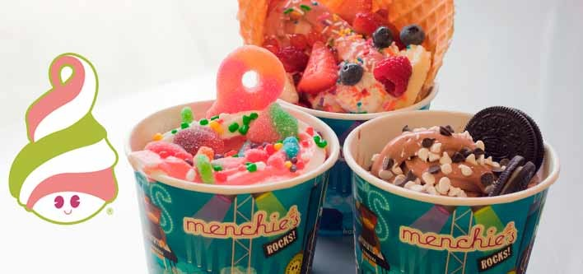
Menchies
By Rhea Deshpande

Slide 2
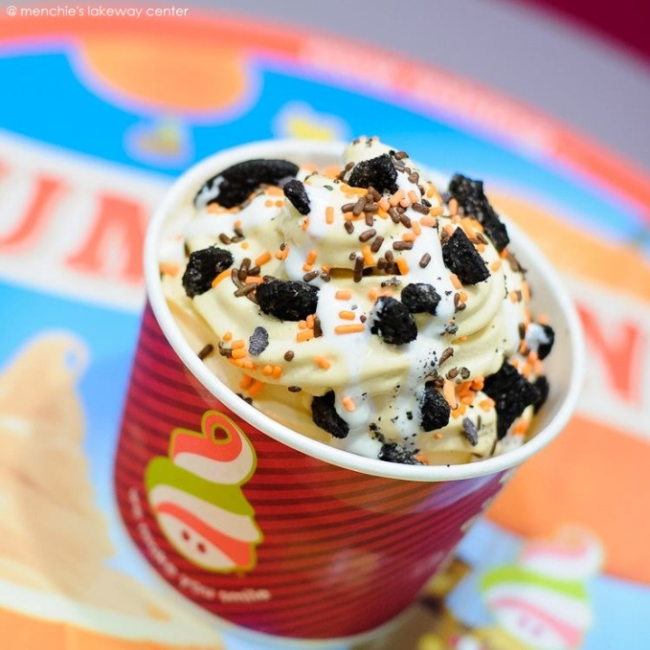
Location
My favorite one is in Mayfield Heights.

Slide 3
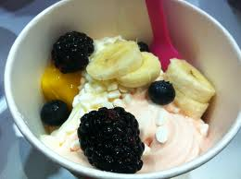
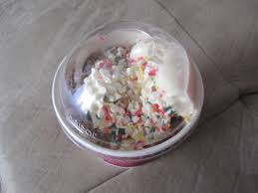
Hours
On Sunday-Thursday the hours are 12pm-10pm and on Friday-Saturday the hours are 12pm-11pm.

Slide 4
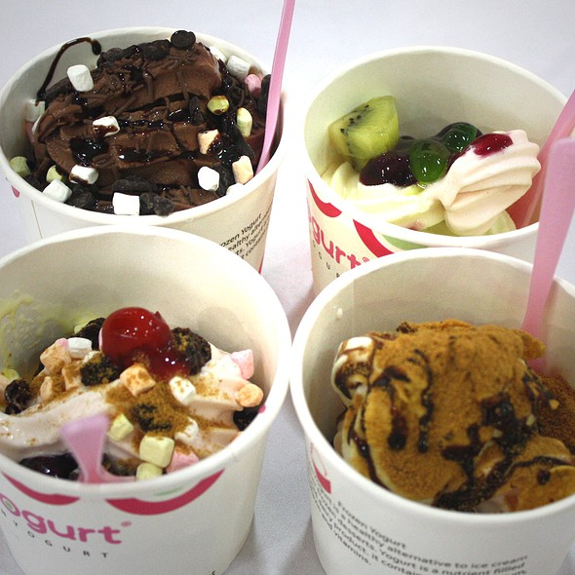
Outside Appearance
You can eat outside in the summer.
I think it’s colorful and clean.

Slide 5
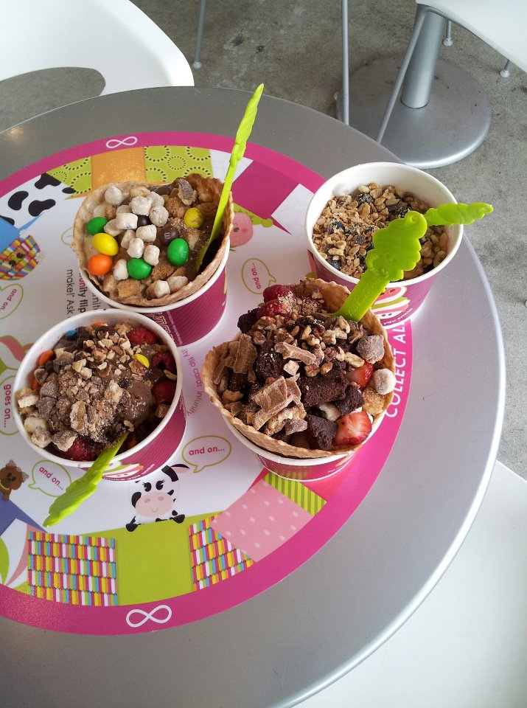
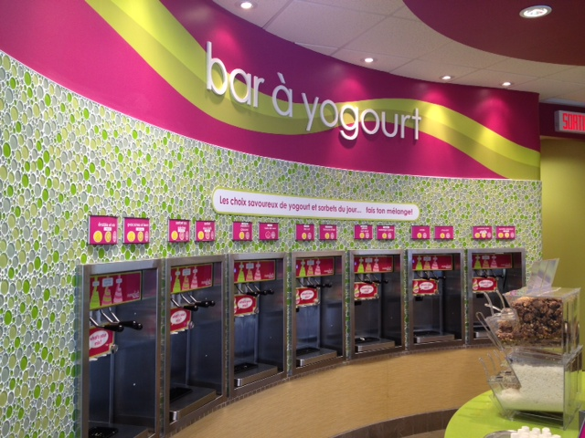
Inside Appearance
It is very clean and you can pick your own toppings.
The toppings are easy to pick.

Slide 6
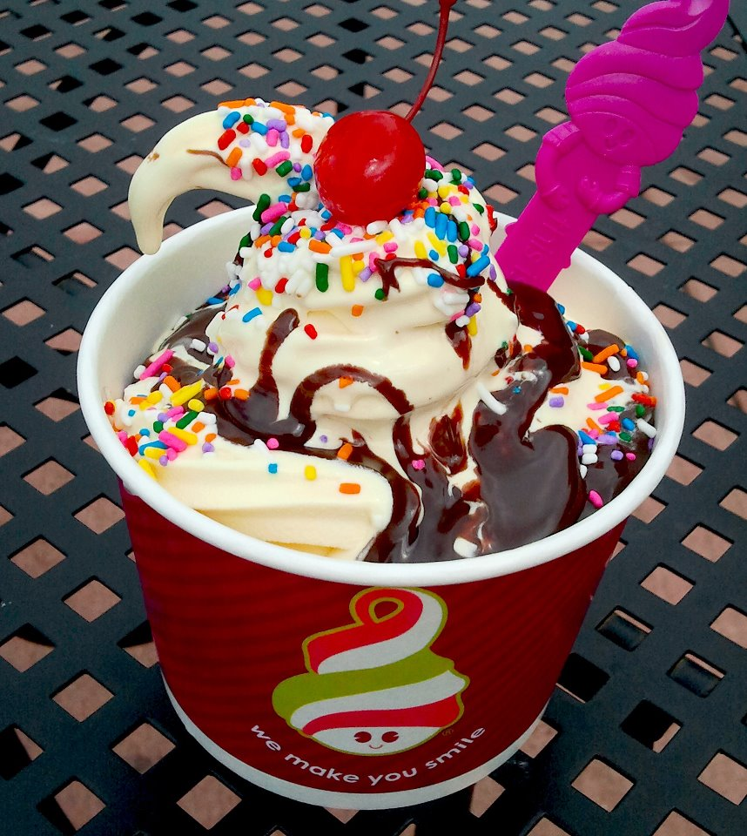
Menu
You can mix flavors of frozen yogurt.
You can also have fruits on your frozen yogurt.

Slide 7
Carry Out
It melts because of the sun.
But I like it melted because it tastes better and it’s not cold.

Slide 8
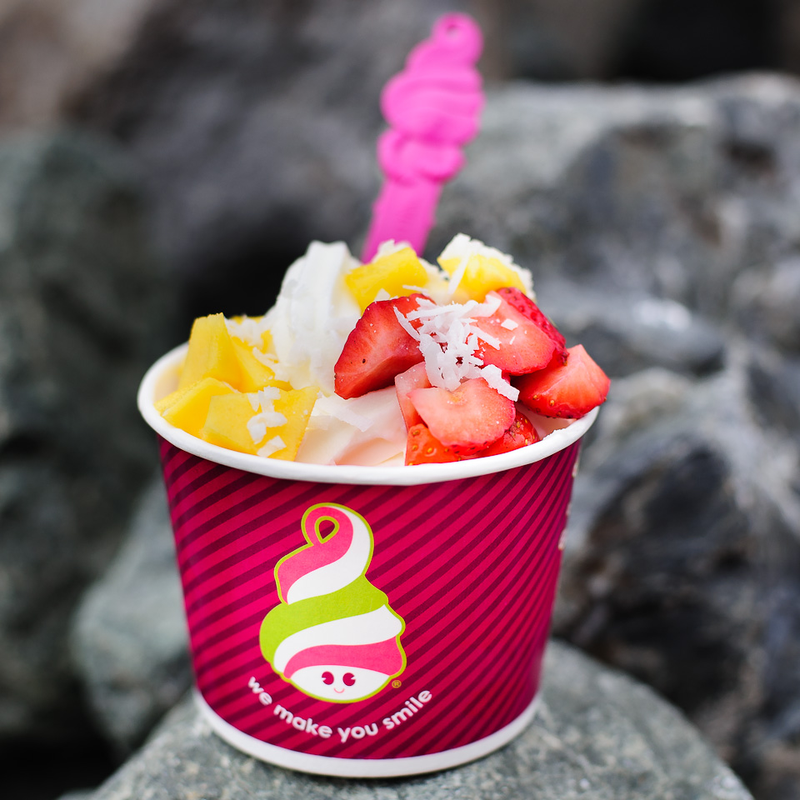
Service
The cashiers are very nice.

Slide 9
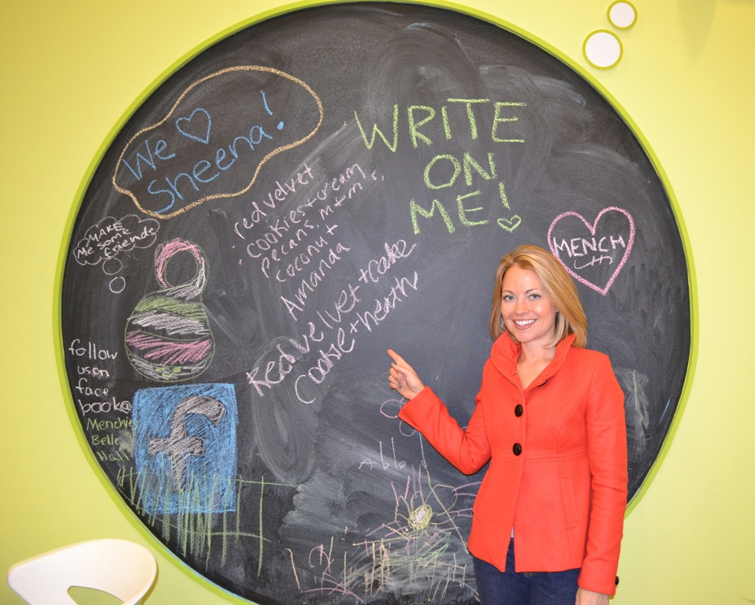
Children’s Activities
They have chalk drawing for little kids.

Slide 10
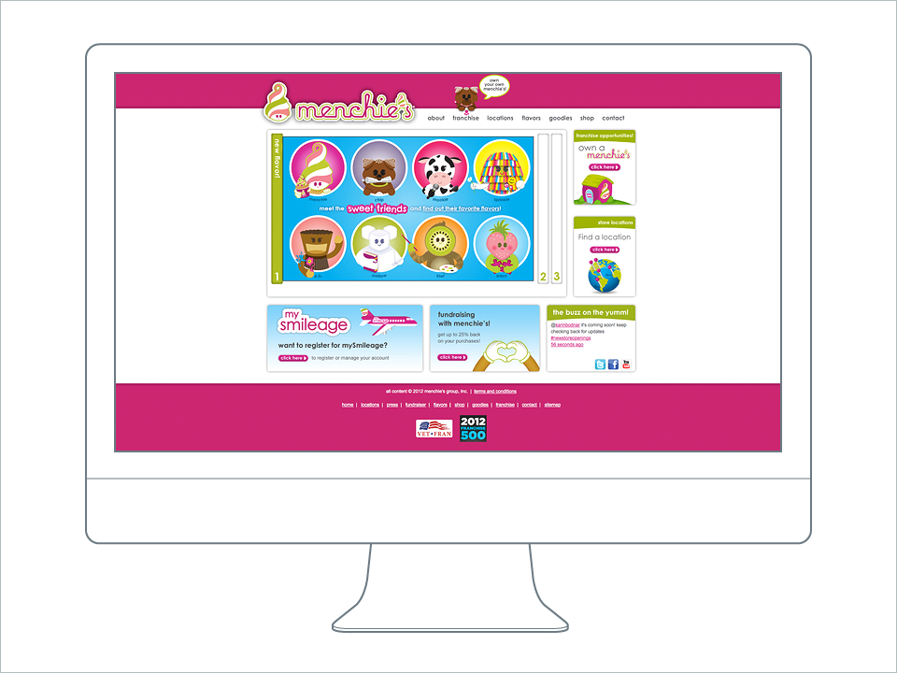
Website
They have a really good website because they show all the flavors.

Slide 11
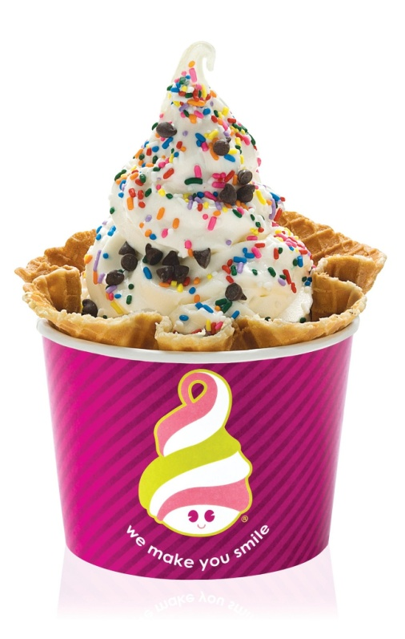
Logo
They have an ice cream man as a symbol.

Slide 12
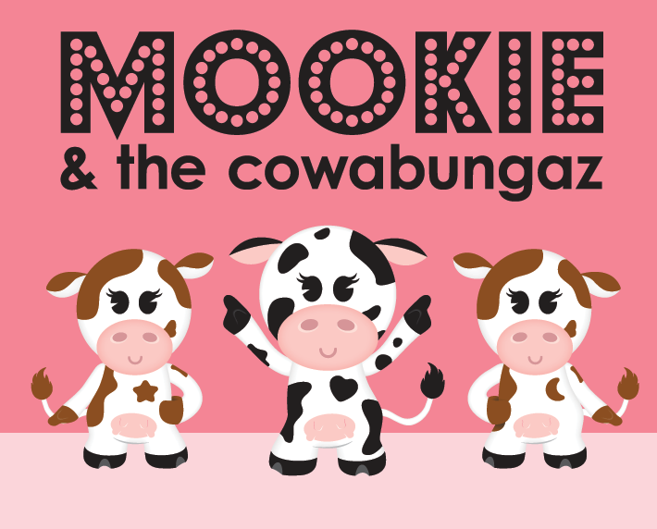
Mascot
Their mascot is Mookie and the Cowabungaz.

Slide 13
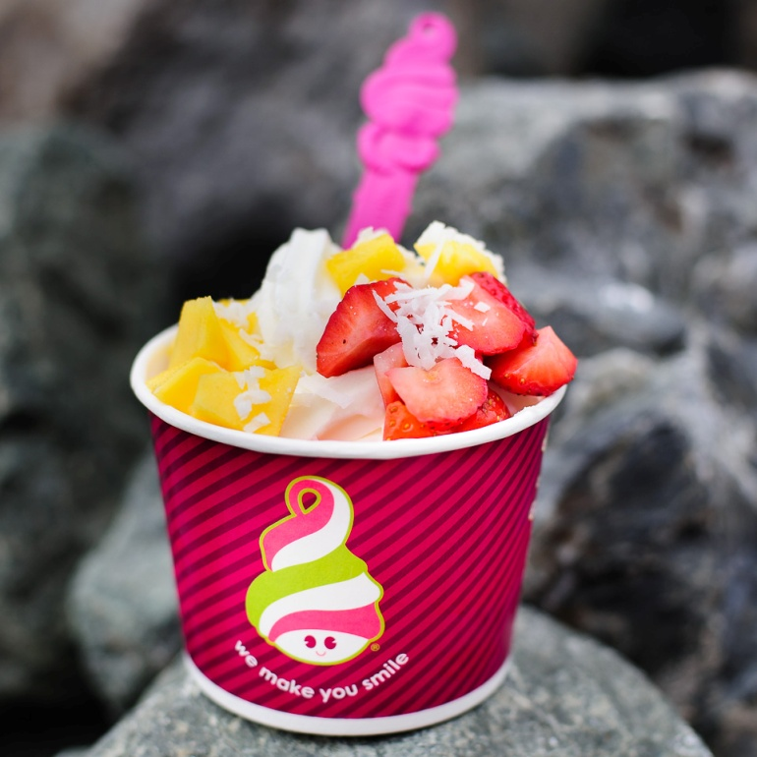
Slogan
Their slogan is we make you smile.

Slide 14
Conclusion
Menchies is my favorite restaurant.
I like everything there.
I really like picking my own toppings and flavors.

