Slide 1
McDonalds
By Nathan Jurcisek

Slide 2
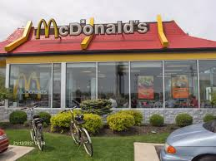
Location
The location is in Mayfield. It is really close to my house.

Slide 3
Hours
It is open 6:30am – 10:00pm everyday.
The drive thru is open 5:00 – 12:00.
They serve breakfast at 5:00 – 10:30.

Slide 4
Outside Appearance
It is very good.
It’s really colorful.

Slide 5
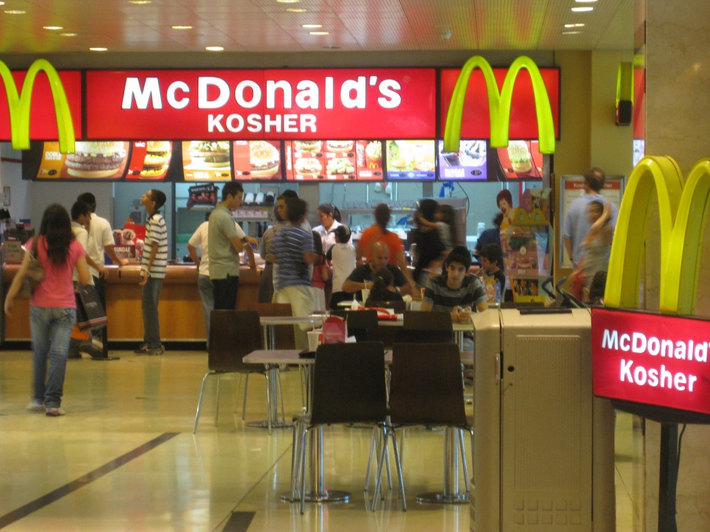
Inside Appearance
It’s okay.
It’s colorful.
I like it.
It’s nice.

Slide 6
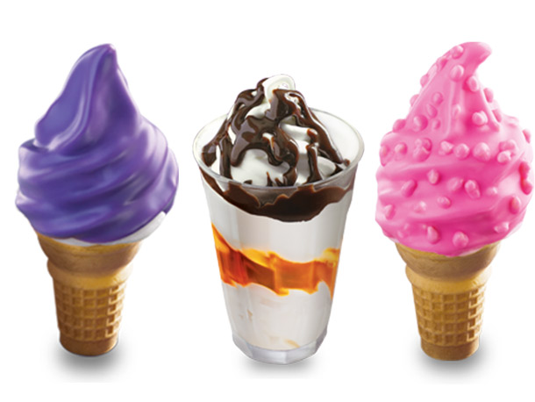
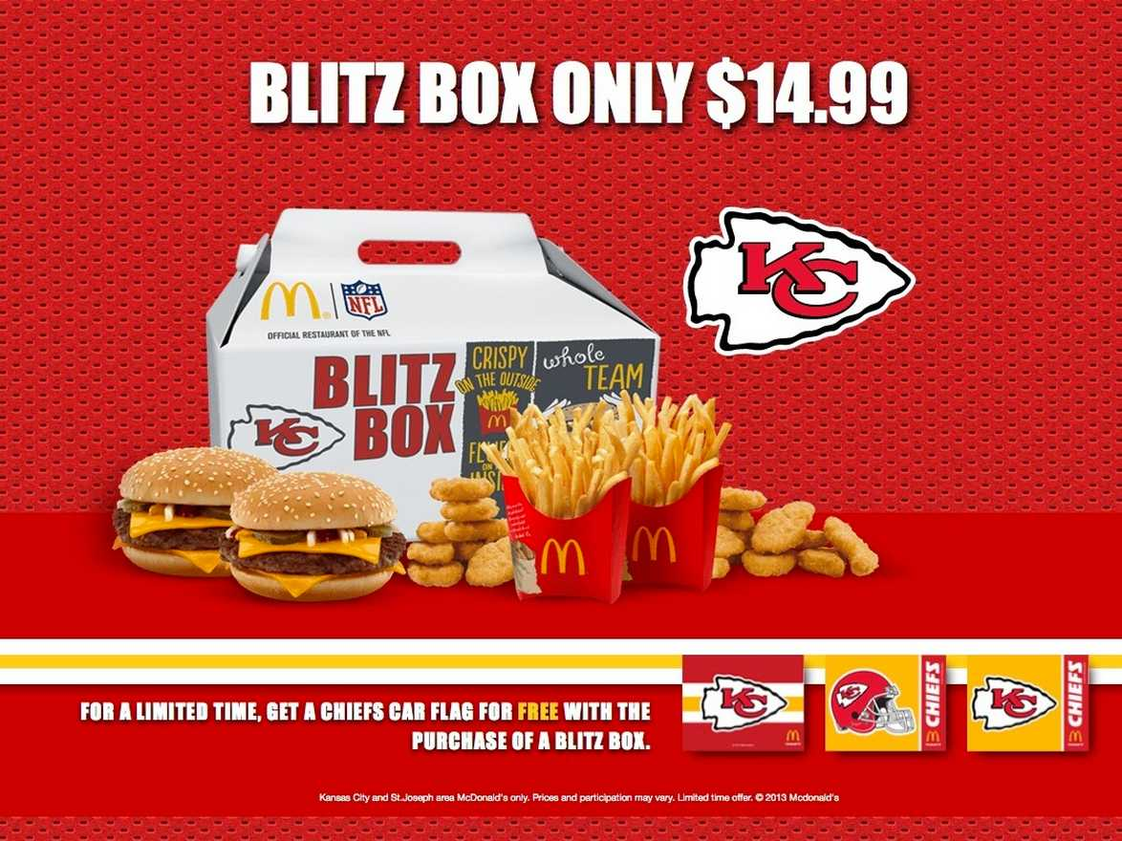
Menu, Children’s Menu
I like the children menu.
I like the chicken nugget’s.

Slide 7
Carry-out or delivery
I really LOVE there delivery.
It is good anytime and everywhere.

Slide 8
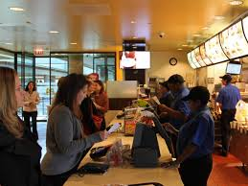
Service
There always very nice to me.
I like them.

Slide 9
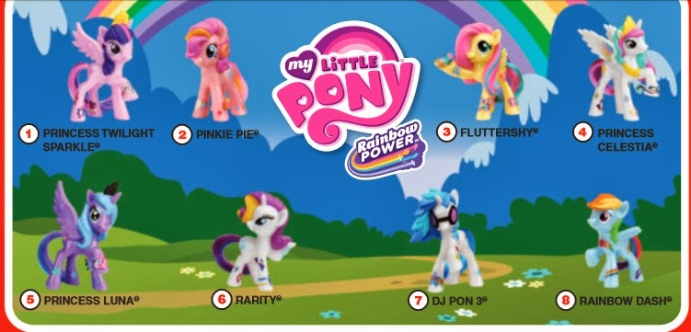
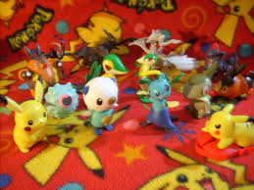
Children Activities
You can get a really cool toy.

Slide 10
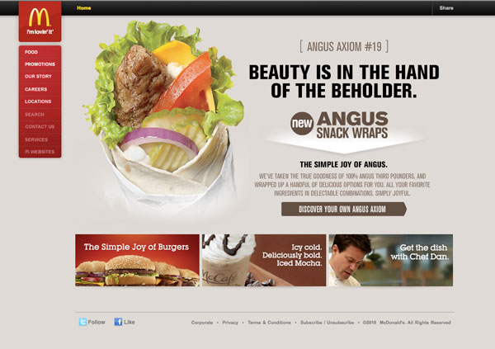
Website
It tells a lot about Mc Donald's.
It is a cool website.

Slide 11
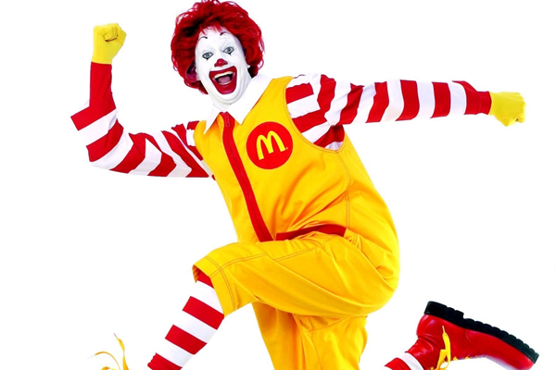
Mascot
The mascot is Ronald McDonald.

Slide 12
Logo
The logo is a gold arch.

Slide 13
Slogan
The slogan is I’m lovin it!

Slide 14
Conclusion
The one thing I like about McDonalds is that they have really really good food!
There is nothing I do not like.

