Slide 1

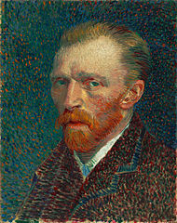
Vincent van Gogh
Fishing Boats on the Beach at Saint-Maries

Slide 2
Vincent van Gogh
Occupation: Artist, Painter
Born: March 30, 1853 in Zundert, Netherlands
Died: July 29, 1890 in Auvers-sur-Oise, France age 37
Famous works: Starry Night, The Bedroom, Irises, Sunflowers
Style/Period: Expressionism, Post-impressionist, Modern Art

Slide 3
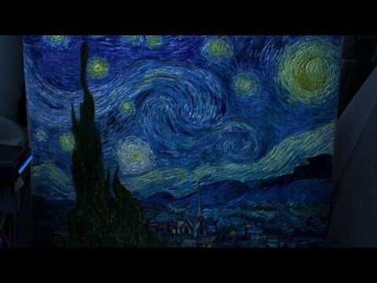
Vincent van Gogh
What is Post-Impressionism/Expressionism?

Slide 4
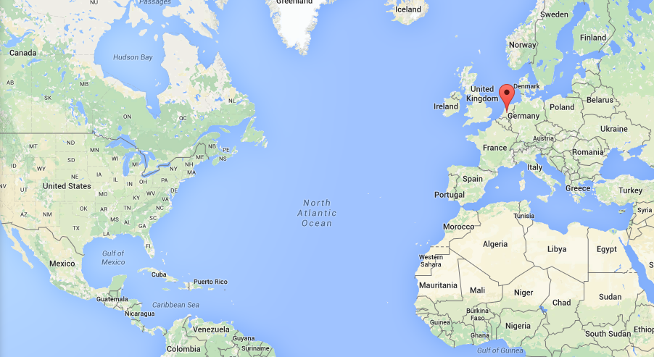
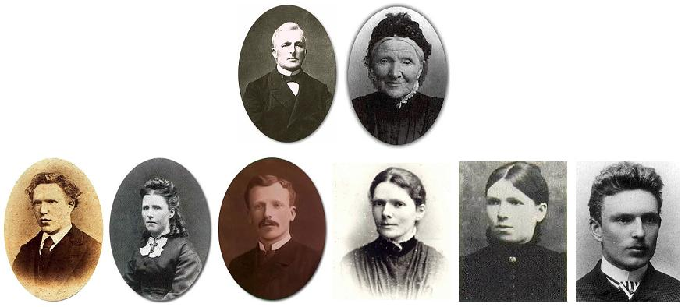
Vincent van Gogh
Vincent van Gogh was born in the Netherlands in 1853. His father and grandfather were ministers, but others in his family worked in the art world. Vincent had two brothers and three sisters. He was closest to his younger brother Theo.

Slide 5
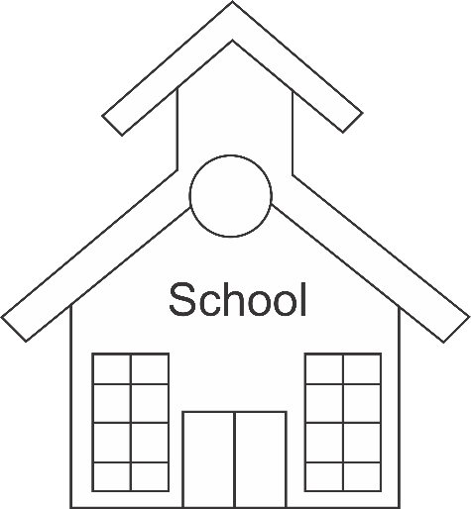



Vincent van Gogh
Although he enjoyed drawing from the time he was a young boy, Vincent had a number of other jobs before he decided to work as an artist full time. He worked as a teacher in London and then as a minister. He also worked in a book store, an art gallery, and as a missionary. At around the age of 27, van Gogh decided to devote himself completely to art.

Slide 6
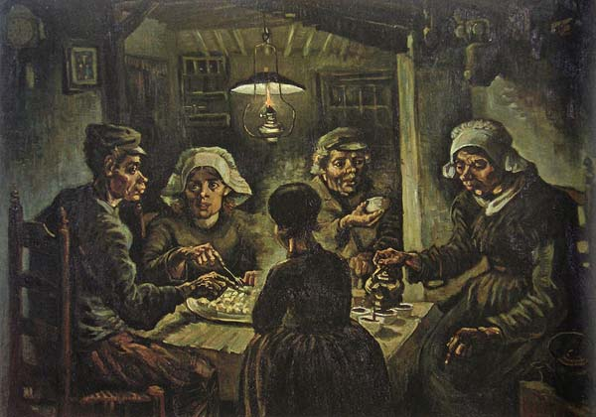
Vincent van Gogh
Early Years:
When Vincent first started drawing he sketched pictures using pencils or charcoal sticks. He used some watercolors as well. He liked to draw pictures of poor hardworking people. Eventually he began to paint using oil paints.
In this early part of his career, van Gogh used a lot of dark colors such as browns and dark greens. His pictures were often somber or sad. His most famous early painting was called The Potato Eaters. It was a dark picture of a peasant family eating potatoes for dinner.

Slide 7
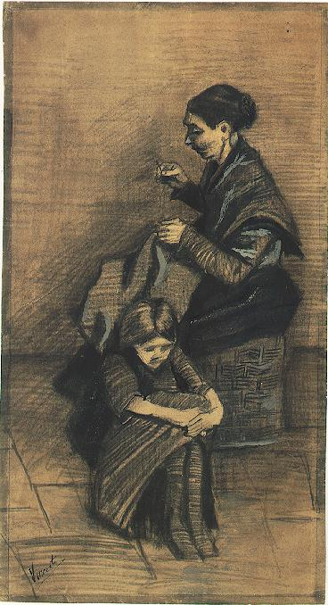
Vincent van Gogh
Letters to His Brother
Much of what we know about van Gogh comes from letters he wrote to his brother Theo. Theo worked in an art gallery in Paris and supported Vincent's art career. He sent Vincent money and encouraged him. Theo tried to sell Vincent's paintings, but no one wanted to buy them.
Woman sewing, with a girl (March 1883)

Slide 8
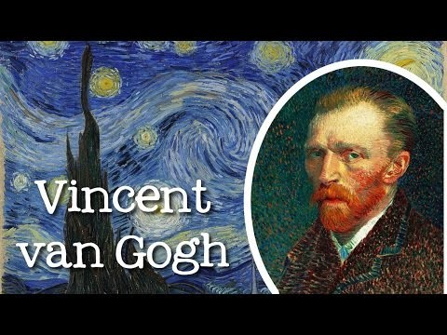
Vincent van Gogh

Slide 9
Vincent van Gogh
Space | Space refers to the area around, below, above and with objects. - Perspective gives the illusion of depth and distance on a flat surface. * Foreground (closest) * Background (farthest) * Middle Ground (between fore- and background) | Can anyone show me the: Foreground, Middle Ground & Background?
Color | A palette is a tray or board on which paint is mixed. Secondary colors are made by mixing sets of primary colors. Complementary colors are two colors opposite on another on a color wheel. A neutral color is not associated with a hue, such as black, white or gray. | - Does anyone know the primary colors? – red, yellow & blue - Does anyone know the secondary colors? – purple, orange & green - Does anyone know what compliments: Red – Green, Blue – Orange & Purple - Yellow
Value | Describes the lightness or darkness of a color. - Shade is the dark value of a color. - Tint is the light value of a color. | - What color do you add to get a different shade of a color? – Black - What color do you add to get a different tint of a color? - White

Slide 10
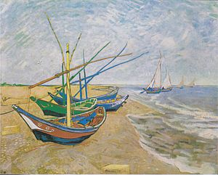

Slide 11
How does this piece of art make you feel?
What is your favorite part of it?
What is your least favorite part of it?
What do you think of the colors?

Slide 12
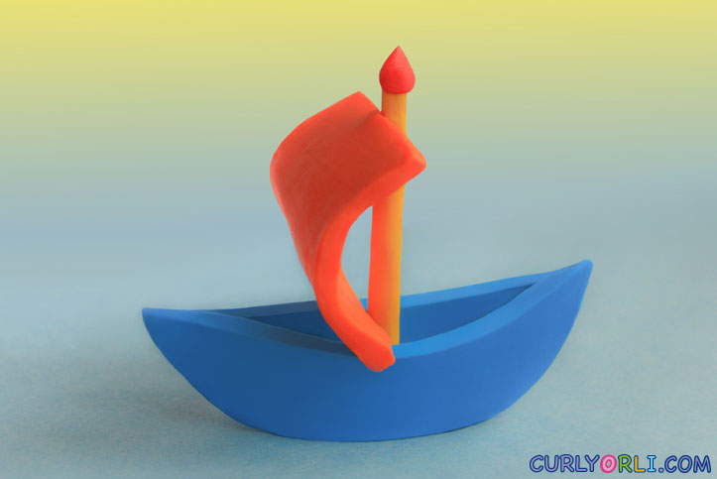
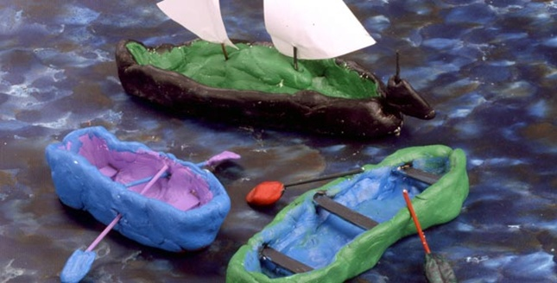
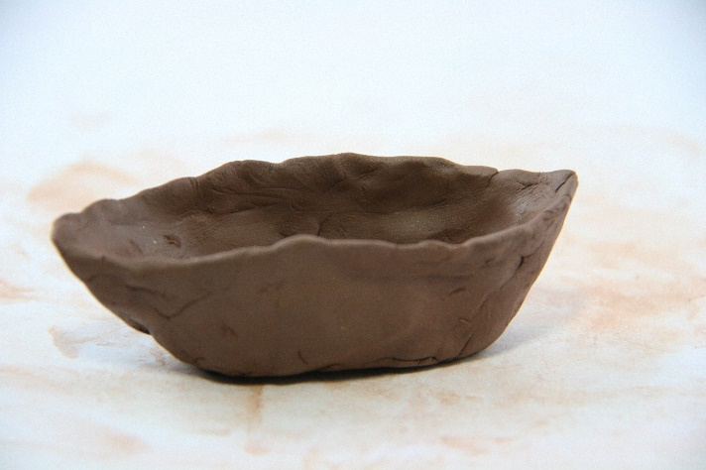
Vincent van Gogh
Fishing Boats on the Beach at Saint-Maries

