Slide 1
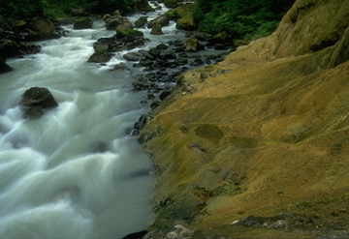
Ch. 4-4
Aquatic Ecosystems

Slide 2
Aquatic Ecosystems
Nearly ¾ of Earth’s surface is covered with water.
Abiotic factors that govern aquatic ecosystems include:
depth of water—determines the amount of light an organism receives
flow of water
temperature of water
chemistry of the water—refers primarily to amount of dissolved chemicals, especially salts, nutrients, and oxygen

Slide 3
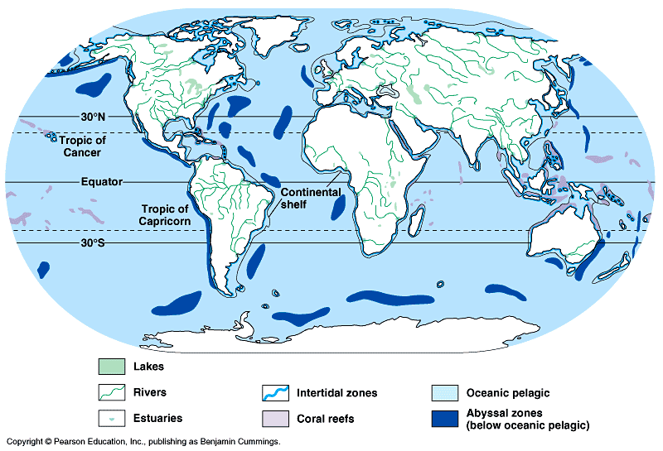
Figure 50.17 The distribution of major aquatic biomes

Slide 4
Freshwater Ecosystems
Only 3% of the surface water on Earth is freshwater.
Divided into two types:
1. flowing-water—rivers, streams, creeks, and brooks
a. organisms well-adapted
to rate of flow
b. originate in mountains or
hills, often from
underground water
source
c. flows swifter near source
and contains more
dissolved oxygen
d. slows down farther
downstream

Slide 5
Standing Water
2. Standing-water—lakes and ponds
a. circulation of water helps distribute heat, oxygen, and nutrients
b. plankton—tiny, freely-floating or weakly swimming organisms that live in both freshwater and saltwater
phytoplankton—single-celled algae
zooplankton—small animals that feed on the phytoplankton

Slide 6
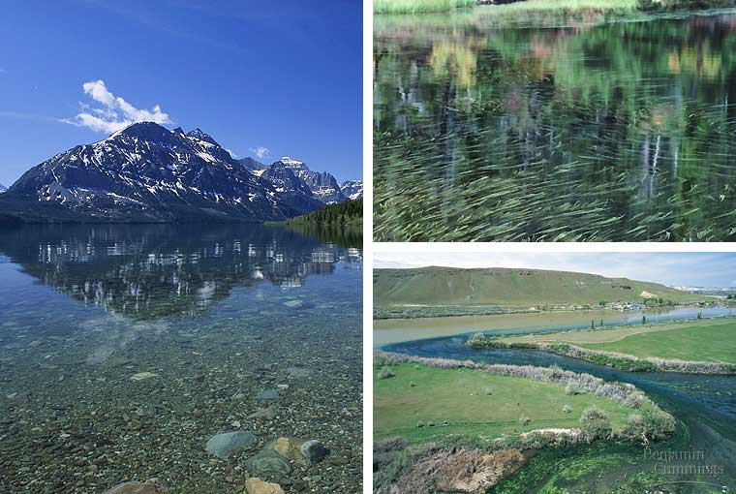
Freshwater biomes: Oligotrophic lake (left), eutrophic lake (top right), stream flowing into a river (bottom right)

Slide 7
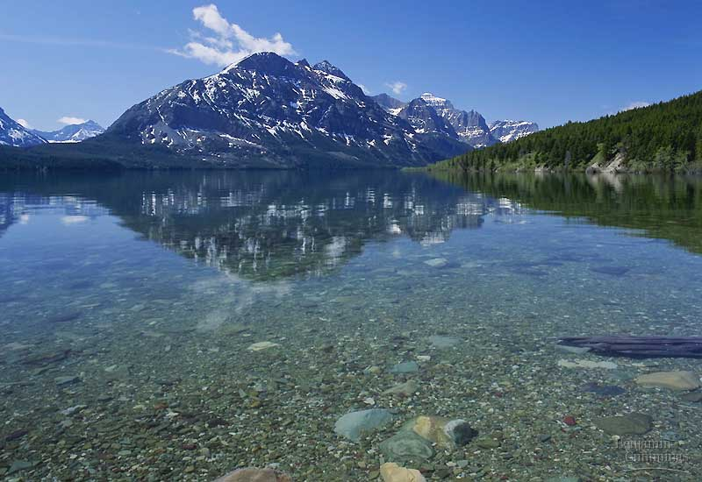
Oligotrophic lake
Oligotrophic lakes are deep, nutrient-poor lakes in which the phytoplankton is not very productive. The water is usually clear; the profundal zone has a high oxygen concentration since little detritus is produced in the limnetic zone to be decomposed.

Slide 8
Eutrophic Lake
Natural eutrophication is the process by which lakes gradually age and become more productive. It normally takes thousands of years to progress. However, humans, through their various cultural activities, have greatly accelerated this process in thousands of lakes around the globe. Cultural or anthropogenic "eutrophication" is water pollution caused by excessive plant nutrients.
View from above Lake 226 divider curtain in August 1973. The bright green colour results
from bluegreen algae (Cyanobacteria), which are growing on phosphorus added to the near side of the curtain.

Slide 9
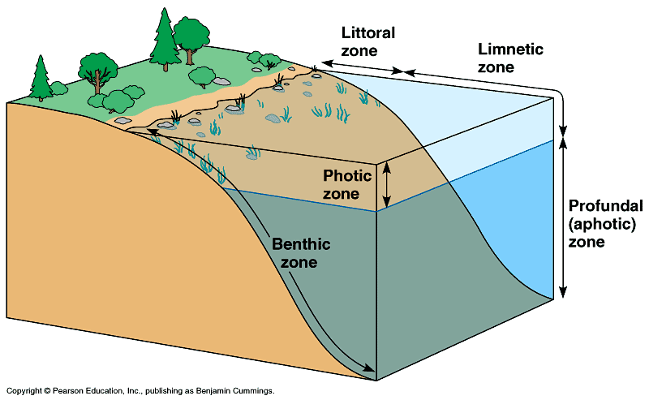
Figure 50.18 Zonation in a lake

Slide 10
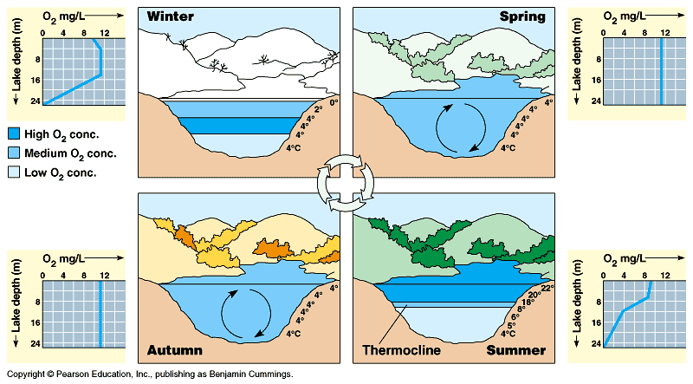
Figure 50.15 Lake stratification and seasonal turnover (Layer 4)

Slide 11
Freshwater Wetlands

Slide 12
3. Freshwater Wetlands—bogs, marshes, and swamps
a. An ecosystem in which water either covers the soil or is present at or near the surface of the soil for at least part of the year.
b. Water may be flowing or standing and fresh, salty, or brackish.
c. Many are very productive ecosystems that serve as breeding grounds for insects, fishes and other aquatic animals, amphibians, and birds.
d. Three main types are bogs, marshes, and swamps.
e. Bogs are very acidic and often contain sphagnum moss.

Slide 13
f. Marshes are shallow wetlands along rivers. Often contain cattails, rushes, and other tall, grasslike plants.
g. Swamps look like flooded forests through which water flows slowly.
h. Some wetlands are wet year-round while others may not always be covered with water.

Slide 14
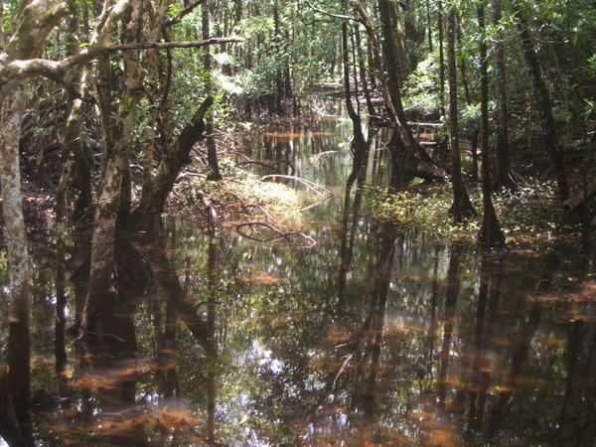
Mangrove Swamps
Coastal wetlands widespread in tropical regions, including southern Florida and Hawaii.
Dominant plants are salt-tolerant trees called mangroves. Seagrasses are also common below the low-tide line.
Also valuable nurseries for fish and shellfish.
Largest in the continental U.S. is within Florida’s Everglades National Park.

Slide 15
Estuaries
Wetlands formed where rivers meet the sea.
Contain a mixture of fresh and salt water and are affected by the ocean tides.
Producers include plants, algae, and both photosynthetic and chemosynthetic bacteria.
Much food enters the food web as detritus which is fed upon by clams, worms, and sponges.
Estuaries are spawning and and nursery grounds for fishes and shellfish such as crabs and shrimps.

Slide 16
Chesapeake Bay estuary
Salt marshes are temperate zone estuaries dominated by salt-tolerant grasses. One of the largest systems of connected salt marshes surrounds the Chesapeake Bay estuary.

Slide 17
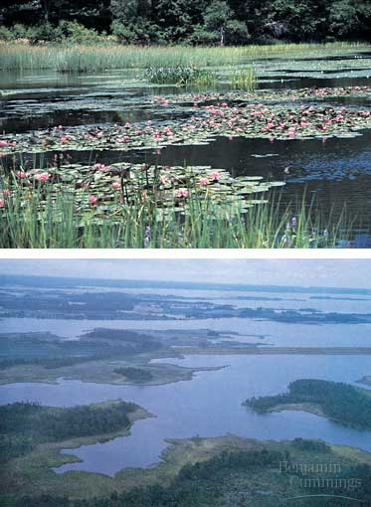
Figure 50.21 Wetlands (top) and estuaries (bottom)

Slide 18
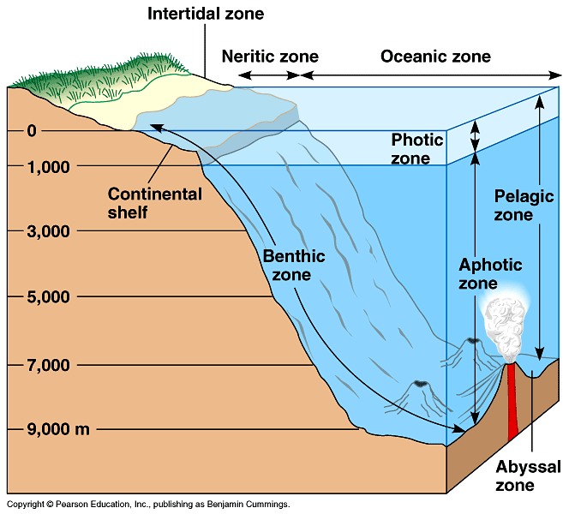
Figure 50.22 Zonation in the marine environment

Slide 19
Marine Ecosystems
Photic zone—where light penetrates, up to 200 m, where algae and other producers grow
Aphotic zone—permanently dark
Three other zones are based on distance from the shore and depth:
Intertidal zone
Coastal ocean
Open ocean or oceanic zone

Slide 20
Intertidal Zone
Organisms are exposed to regular and extreme changes in their surroundings.
Tides go in and out
Battered by waves and currents
Sunlight and temperature changes
Example is the rocky intertidal zone
Highest up is black algae
Next barnacles
Lowest can have mussels and green algae

Slide 21
Coastal Ocean
Extends from the low tide mark to the outer edge of the continental shelf, the border that surrounds the continents.
Most of the continental shelf falls within the photic zone so it is often rich in phytoplankton.

